Slide 1
Registration Form

Slide 2
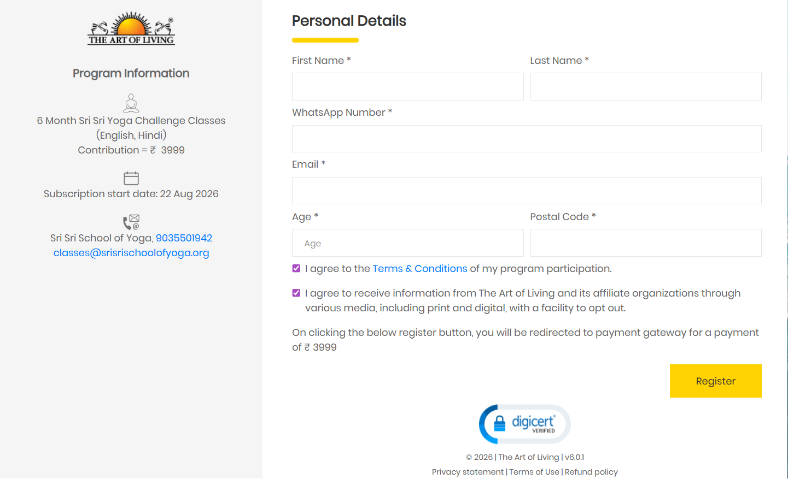
Current Yoga Registration Page
Ref: Yoga Challenge

Slide 3
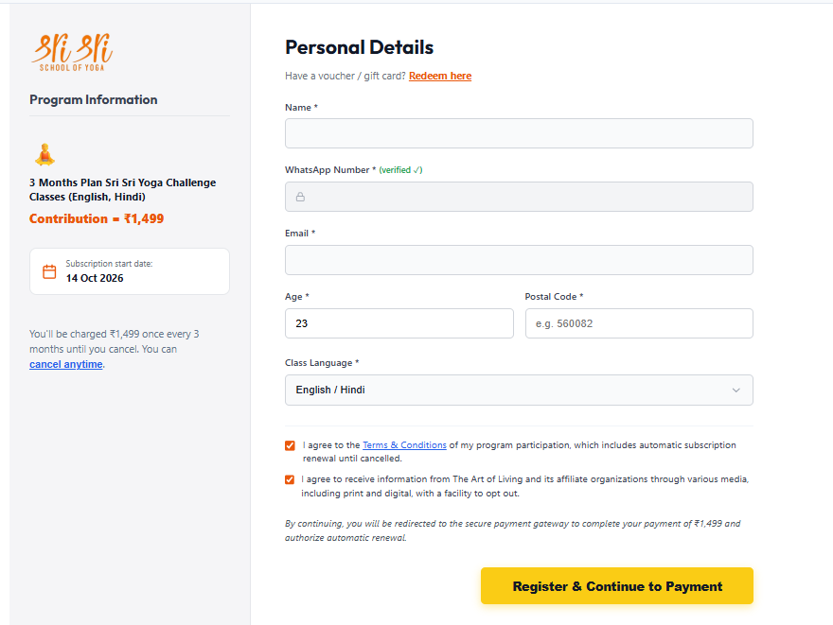
Option 1a

Slide 4
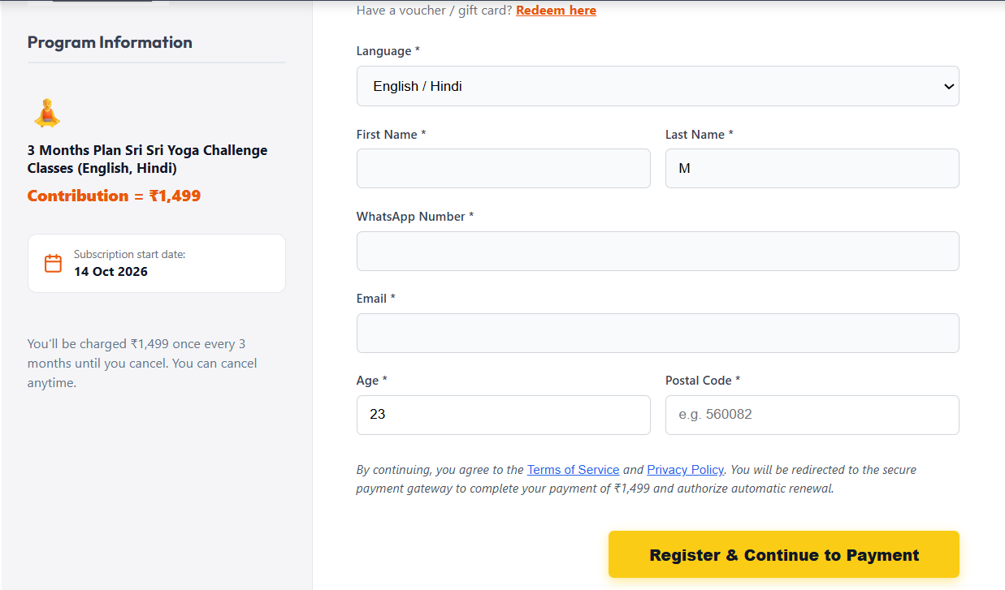
Option 1b

Slide 5


Cult.fit Login Page and offers page

Slide 6
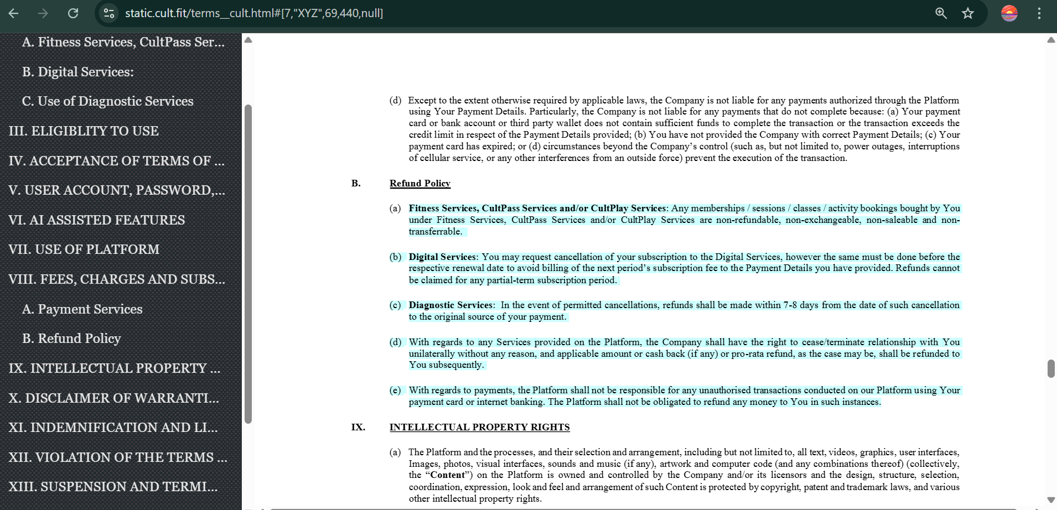
T&C of cultfit

Slide 7

Plans Of cultfit

Slide 8
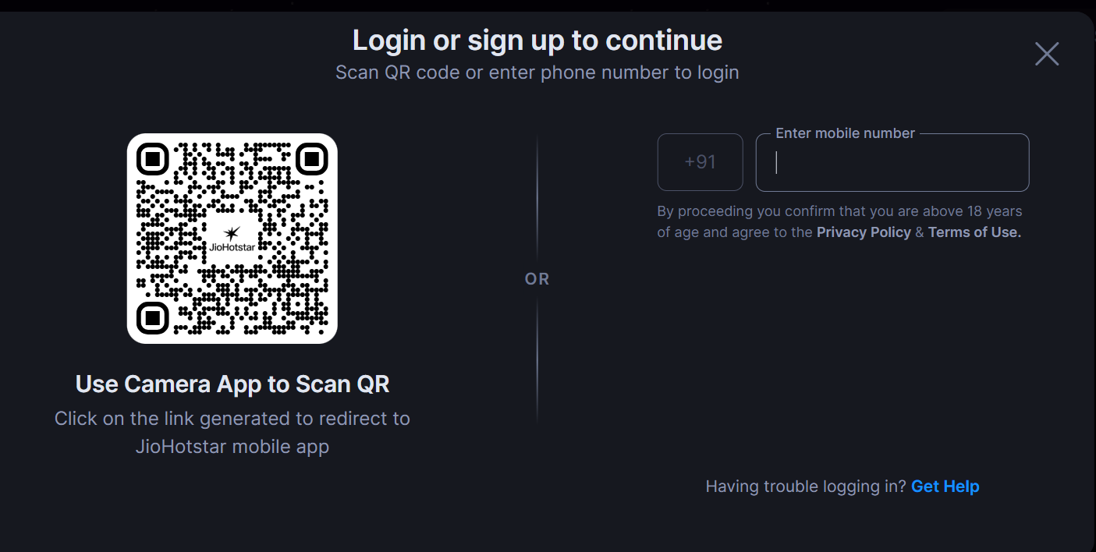
JioHotstar

Slide 9
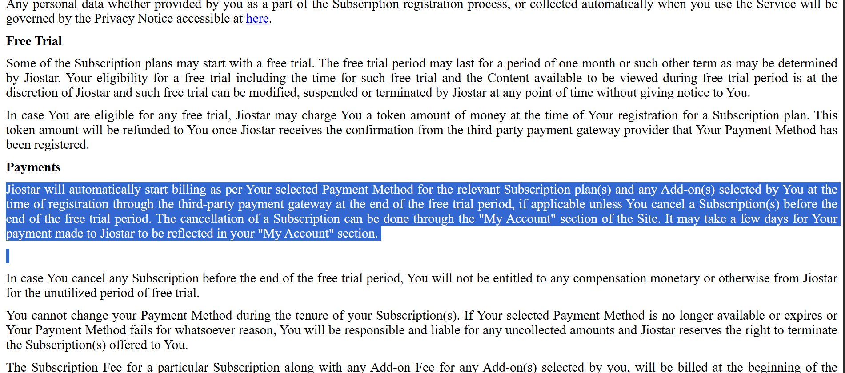
JioHostar T&C

Slide 10

Payment Gateway of Jiohostar

Slide 11
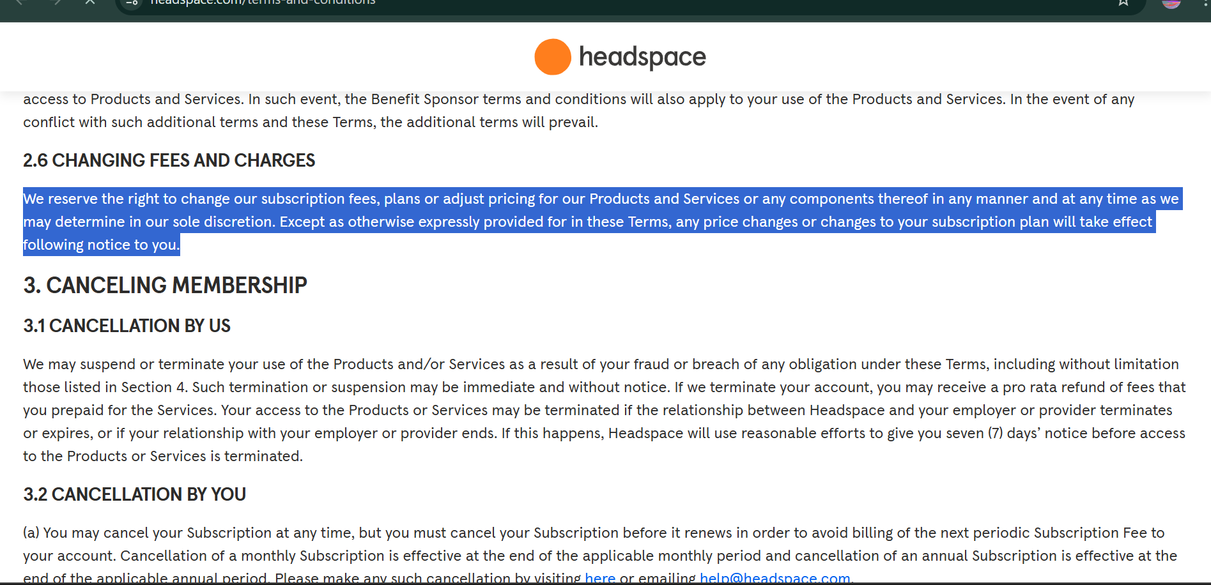
Headspace changing fees we can adopt

Slide 12
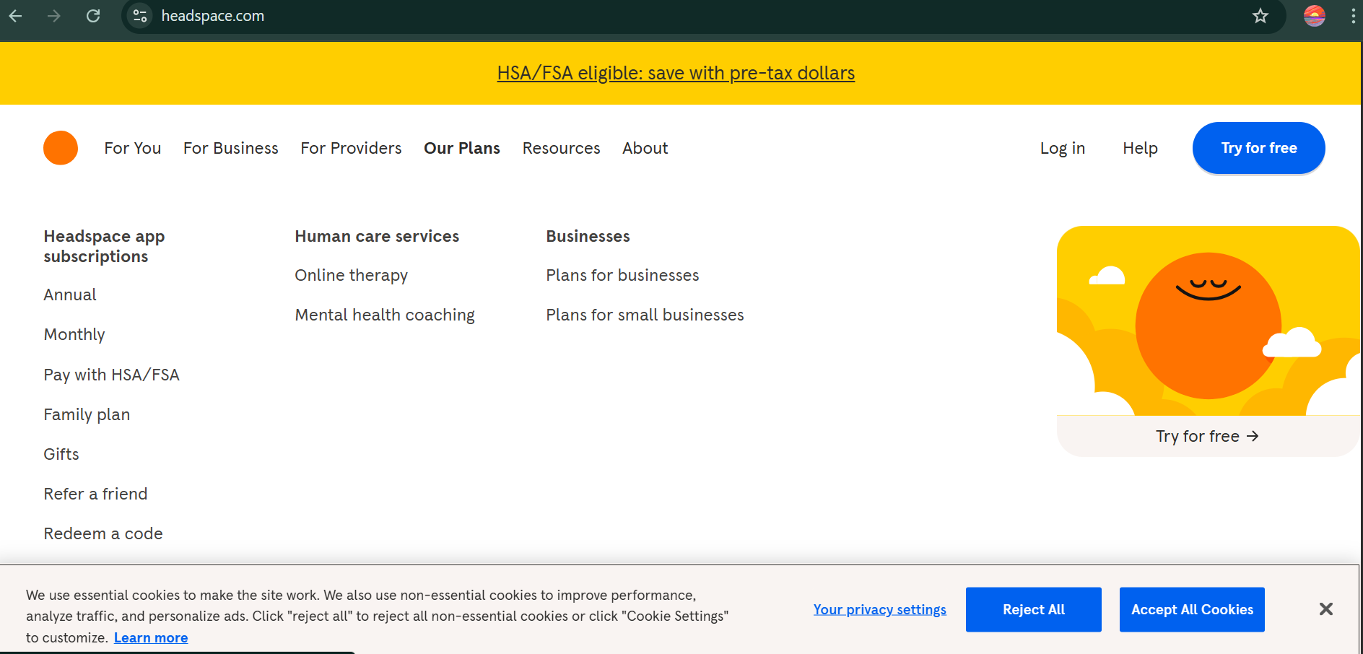
There programs and plans

Slide 13

Cancel anytime redirects to T&C

Slide 14
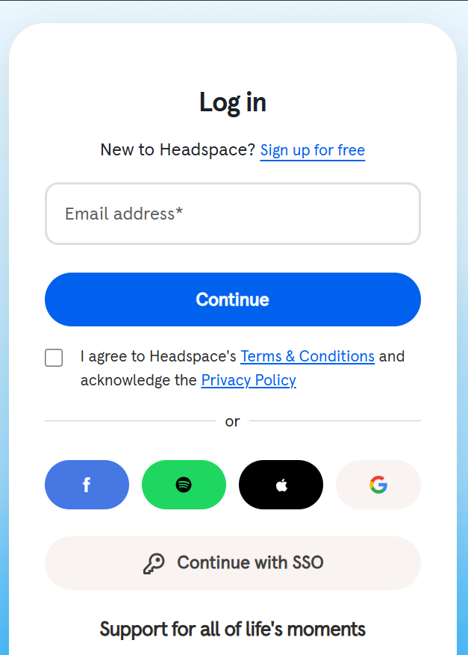
Headspace Login page with

Slide 15
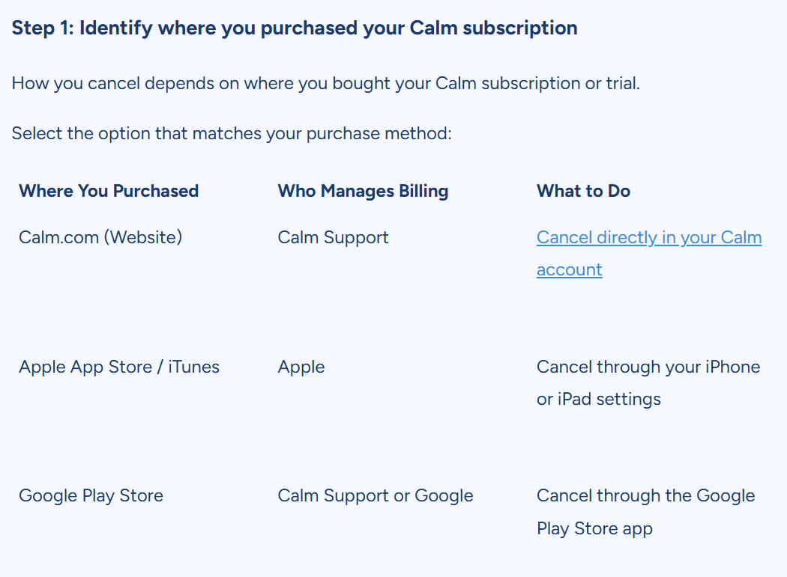

Slide 16
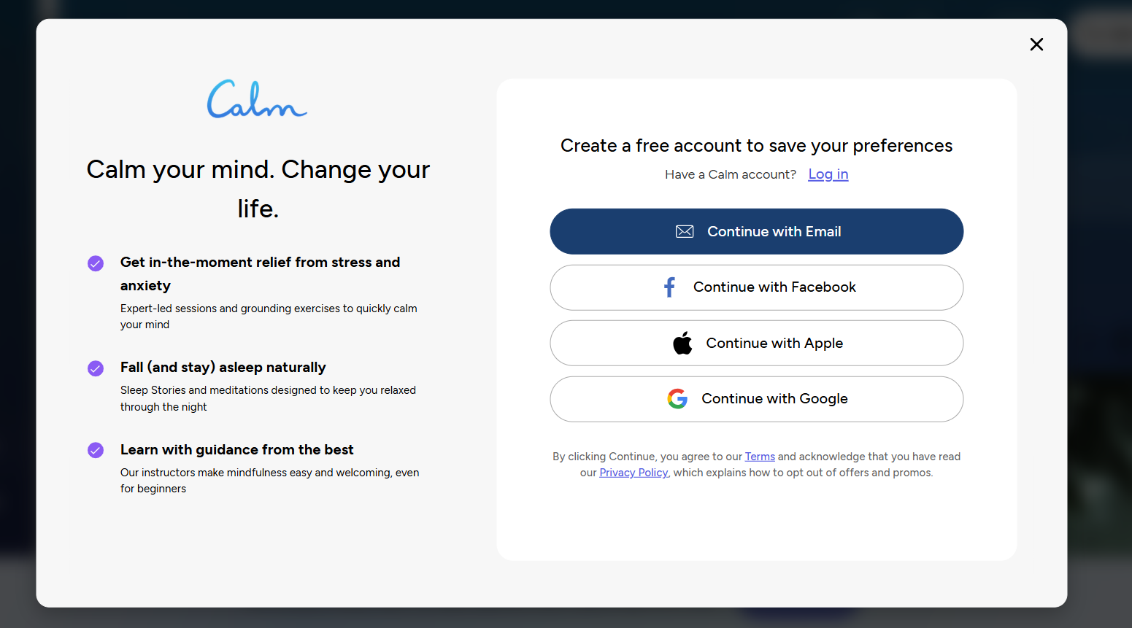

Slide 17
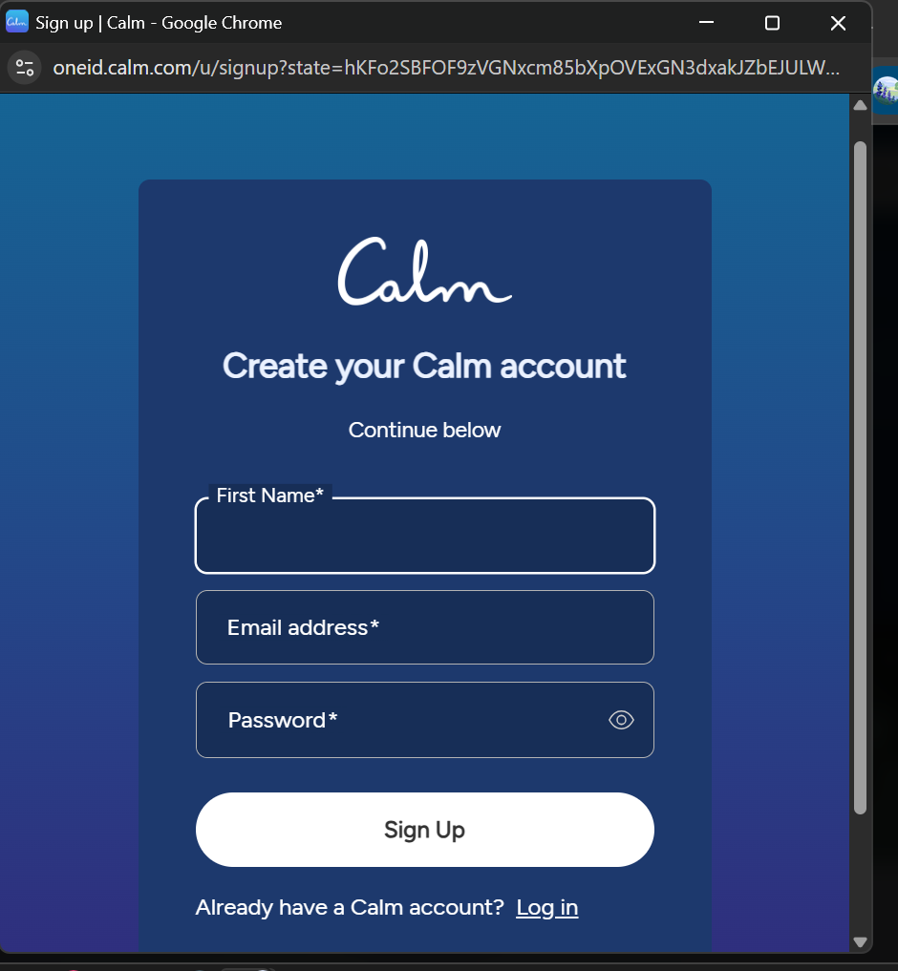

Slide 18
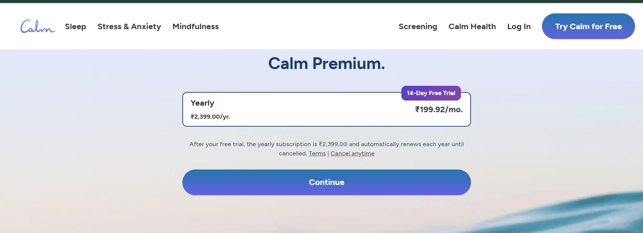

Slide 19


Slide 20


Slide 21


Slide 22
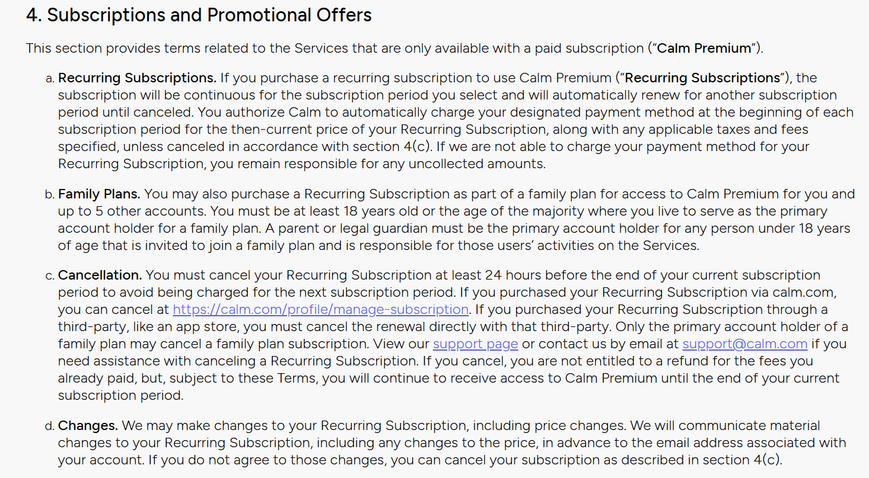


Slide 25
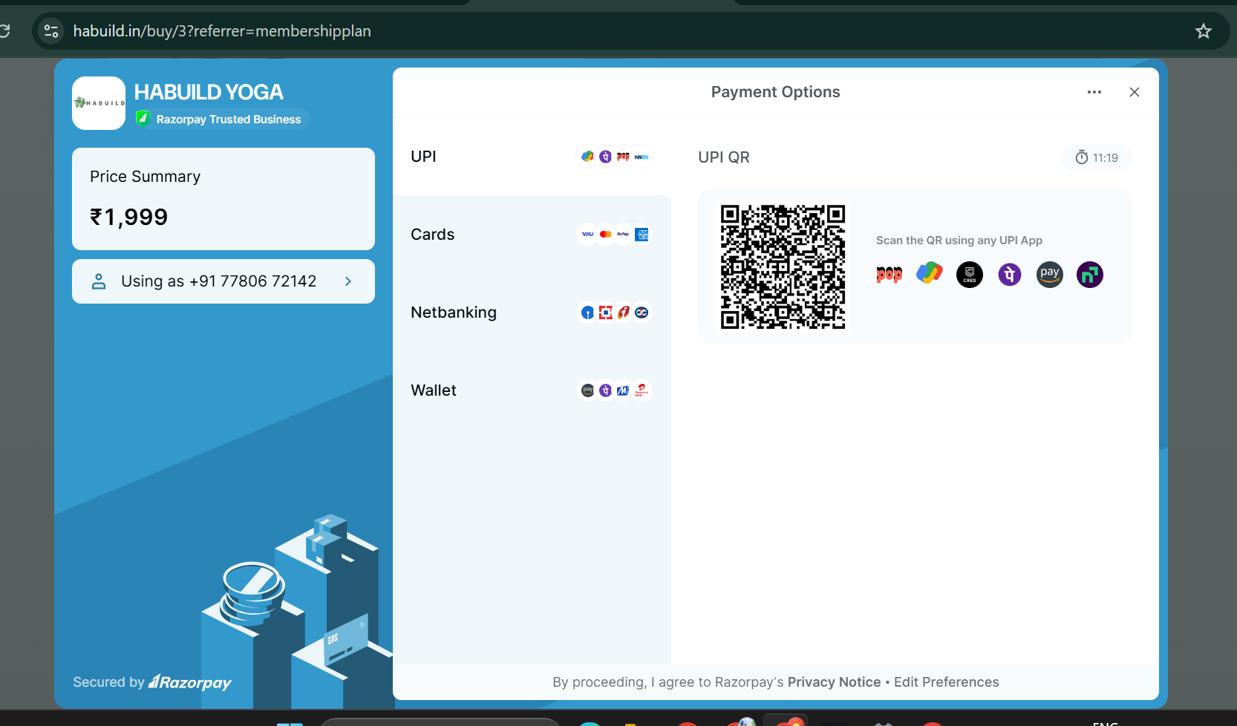

Slide 26


Slide 27


Slide 28


Slide 29
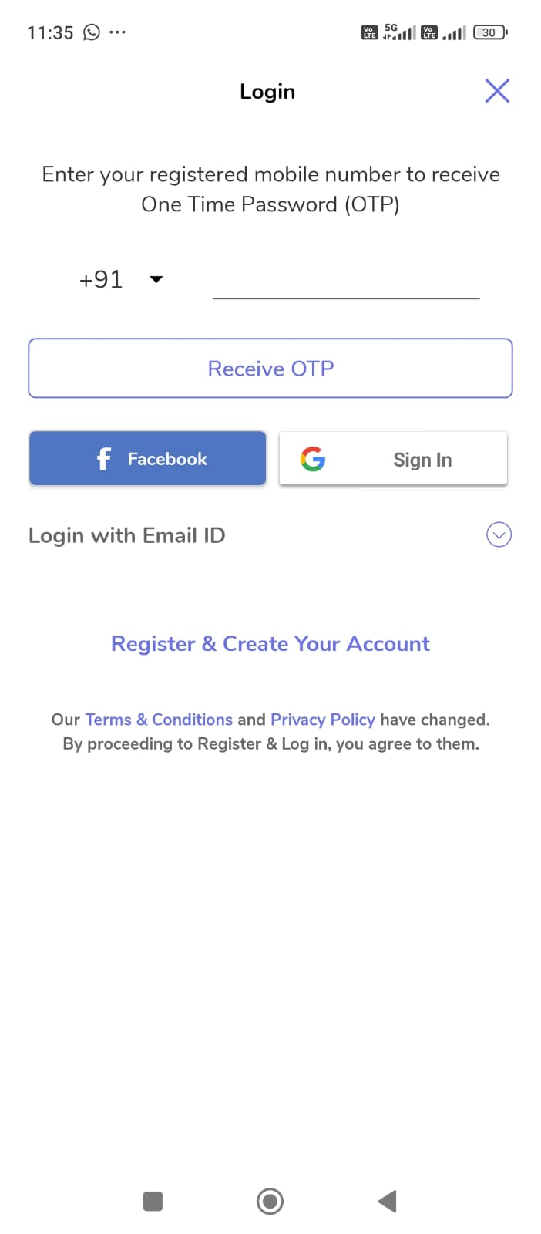
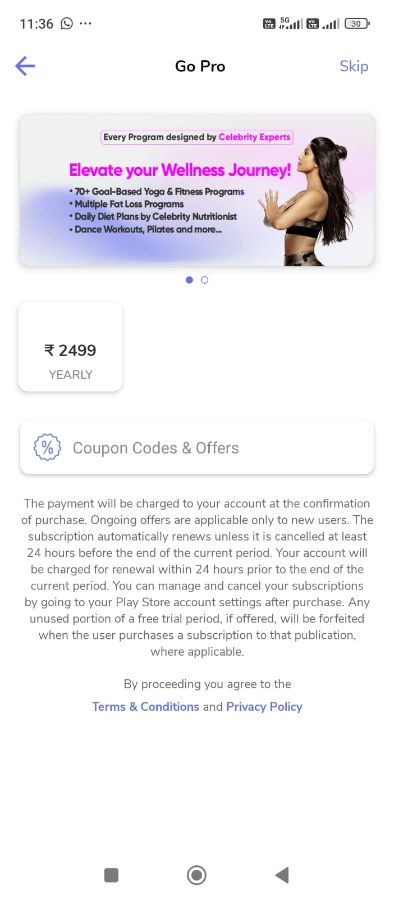

Slide 30

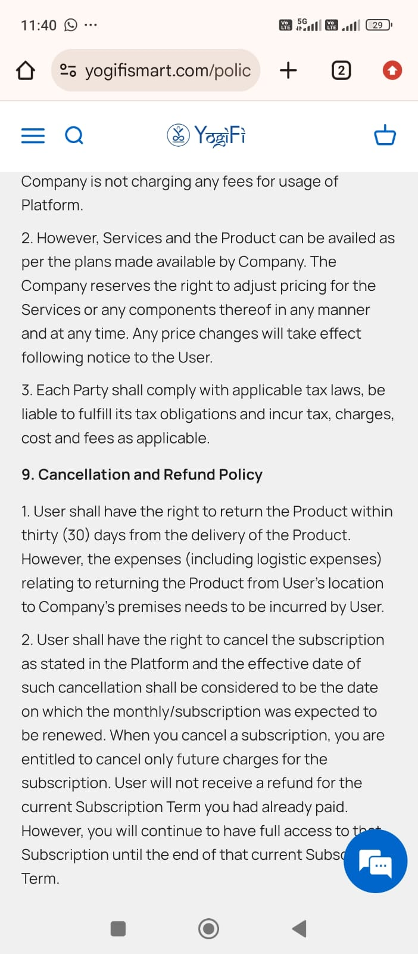

Slide 31
Where do competitors ask users to log in?
Before or after plan exploration?
How do they handle existing subscribers?
Calm

Slide 32
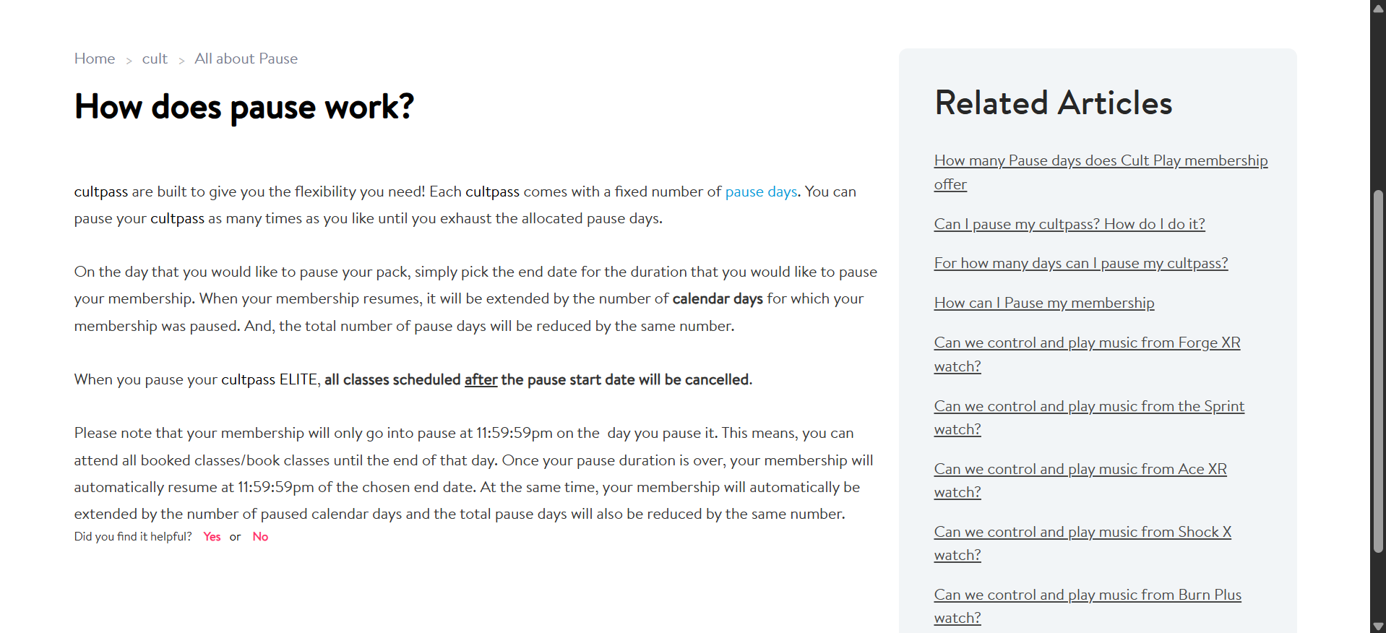

Slide 33
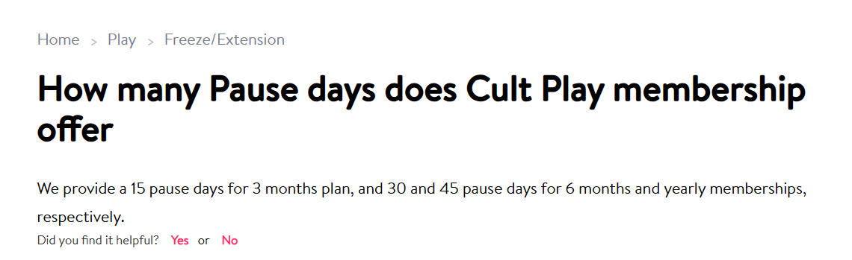

Slide 34


Slide 35
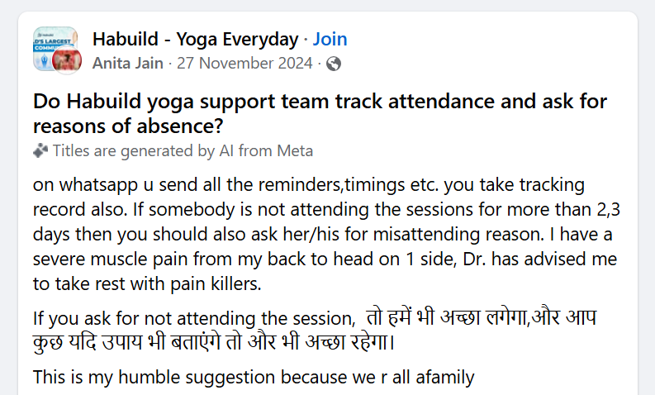

Slide 36
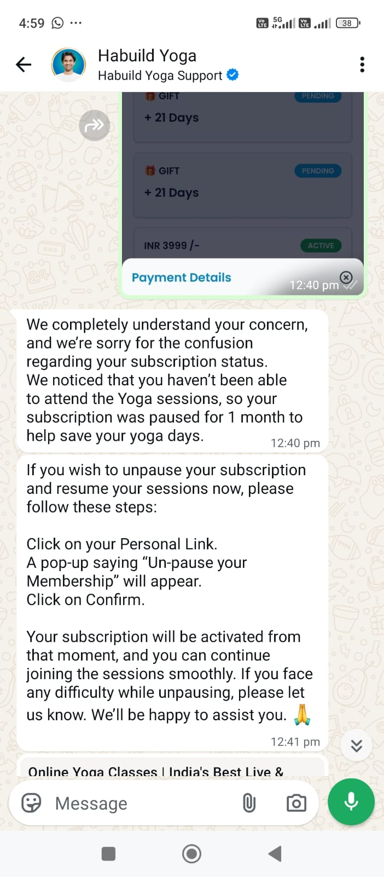
Habuild currently handles pause
requests through its support team and whatsApp
rather than an automatic in-app pause option

Slide 37
